Slide 1

Title Page: E-Learning Design Trends 2022
E-Learning
Design Trends
2022
Notes:
Photo: https://nappy.co/photo/2154

Slide 2


Why does exploring trends matter
Why does
exploring trends
matter?
Notes:
While it can be exciting to try new approaches, many of us have had at least one shaky experience with e-learning design trends. From aesthetics that look dated quickly to a flashy new approach that isn’t a good fit for the audience or content, trends have the potential to weaken a design.
So why follow them then? First, trends in our field and related fields (like graphic design and web design) shape what looks “modern” to learners and stakeholders. Whether you use them or not, they can impact how people judge your work. But even more importantly, trends can help you discover smart new ways to share and display information. So you don’t need to avoid trends; you just need to find out how to use them strategically.
This report will help you better understand the strengths (and occasional weaknesses) of the design trends we’re seeing for the upcoming year. You’ll explore what you need to know to evaluate them and use them thoughtfully—whether on their own or woven together with the longstanding design techniques you already know and trust.

Slide 3
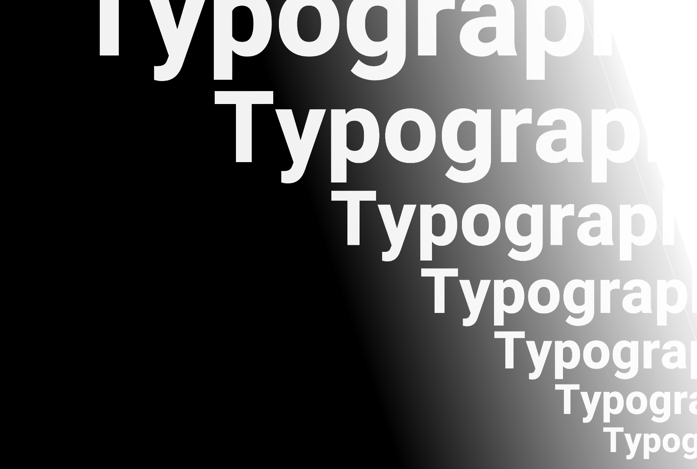
Trend 1: Oversized Typography
01
Oversized
Typography
Notes:
Using text as the focal point of a design can be an unexpected way to shape your visual narrative. Whether as the main image on a slide or a callout, oversized text can provide a welcome shake-up to the look and feel of your courses. But for this technique to work, you need to keep two things in mind:

Slide 4



Trend 1: More Information
Just remember:
Choose text that reinforces key ideas
Use oversized text to
CALL OUT
your biggest ideas
Select fonts and spacing carefully
Notes:
First, it’s most effective when the specific text you enlarge reinforces a key idea. Main topics, summarized points, and short quotes tend to be your best bets. Second, the larger your text is, the more apparent font design issues become. Some fonts that work well for small text don’t make a big impact when enlarged, so try out a few options before committing to one. Once that’s settled, you may still need to make a few manual adjustments to your leading (the vertical space between lines of text) and kerning (the space between letters and characters) so none of the text characters look too close together or too far apart.
ELH Example: Storyline: A Visual Guide to the Anatomy of Typography
ELH Example: Storyline: Animated Text Intro
Additional Reading: 33 Brilliant Examples of Type in Web Design

Slide 5
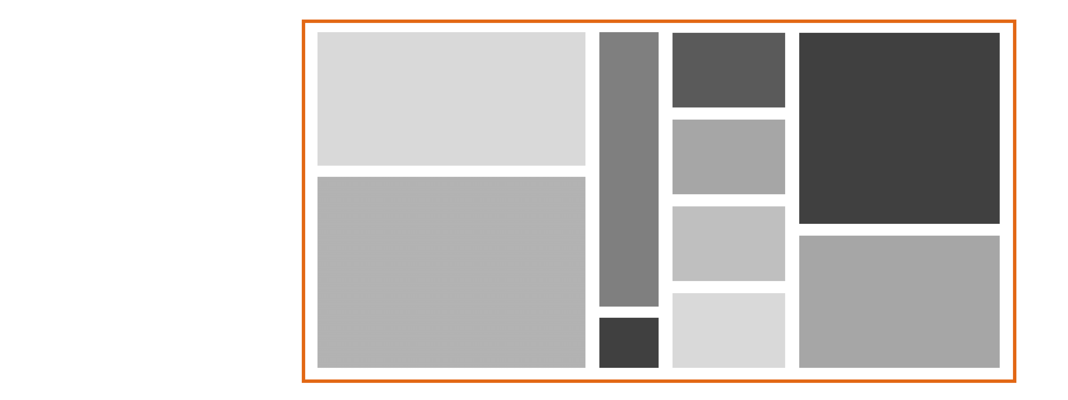
Trend 2: Bold Lines
02
Bold
Lines
Notes:
For many years design trends favored no outlines, indicating buttons, tabs, and sections with simple color blocking and contrast instead. But lines are making a comeback. Whether they’re pencil-thin, bold and thick, or even filled with a gradient, outlines are regaining popularity as ways to organize layouts.

Slide 6
Trend 2: More Information
Just remember:
Avoid clutter
Aim for simplicity
Notes:
When using line work in your designs, be careful to avoid clutter. Too many lines or spacing them too close together can make your design feel busy and hard to process. Simplicity and white space are your friends here. Simplicity helps with your line weight choices as well. Using just one or two line weights consistently throughout your e-learning project will help the final design look purposeful and cohesive.
ELH Example: Storyline: Sleek, Modern Tabs Template
ELH Example: Storyline: Click-and-Reveal Grid Template
ELH Example: Storyline: Gamified Quiz Template with Timer

Slide 7

Trend 3: Micro Animations
03
Micro
Animations
Notes:
Micro animations are short snippets of on-screen movement. Some are decorative, simply adding visual pop to a design. But they can also be instructive—adding emphasis, directing the viewer’s eye, or even sharing processes. Often created as GIFs, the format is lightweight compared to video files.
Image: https://lottiefiles.com/76019-successful-location-verification

Slide 8
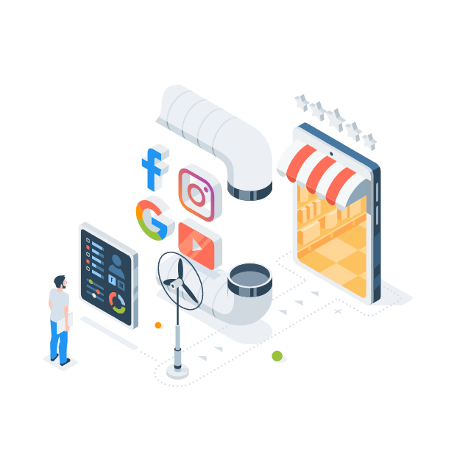
Trend 3: More Information
Just remember:
Consider if it’s a fit for the content and audience
Include features that enhance accessibility
Notes:
A drawback, though, is that micro animations often lack player controls. This means the format can be a bad fit for complex information where learners might want to pause and rewind to fully grasp what’s shared. They can also be a challenge for people with disabilities that are aggravated by excessive on-screen motion.
If the content in an animation is essential, be sure to add alternative (alt) text for learners using screenreaders. And in all cases, avoiding looping can improve accessibility, as can keeping animations under 5 seconds or allowing learners to pause the content. ELH Example: 13 Time-Themed Animated GIF Icons
ELH Example: Rise 360: Beer Brewing Process
Additional Reading: 5 Ways to Use Animated GIFs in Your E-Learning
Additional Reading: Web Content Accessibility Guidelines (WCAG) 2.1 - Success Criterion 2.2.2 Pause, Stop, Hide
Image: https://lottiefiles.com/88548-conversions

Slide 9
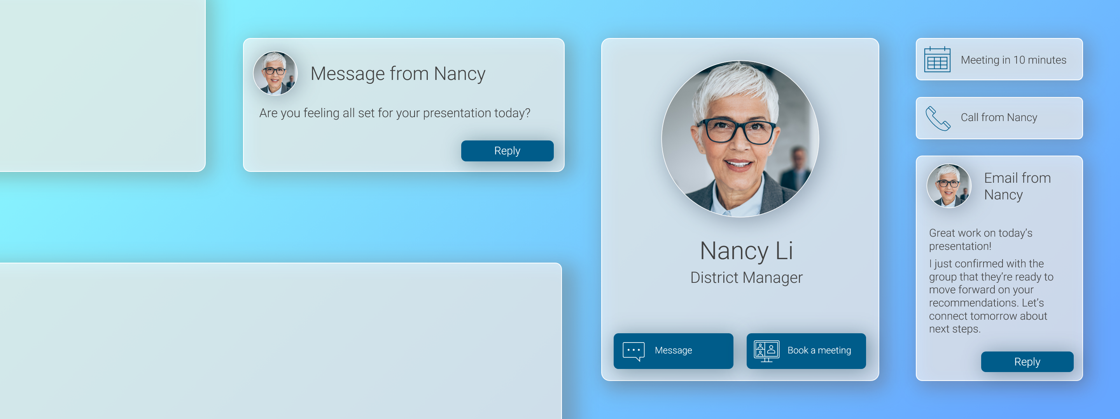
Trend 4: Glassmorphism
04
Glassmorphism
Notes:
A visual style popularized by both Apple and apps, glassmorphism’s name comes from its resemblance to frosted glass. It uses semi-transparent shapes and sections that blur the background and cast a slight shadow, giving the feel of glass layers floating just above a surface. Best paired with vibrant backgrounds, glassmorphism can create friendly and inviting designs that feel modern. But if you’re not careful, this visual style can be a serious barrier to accessibility.
Gradient from WebGradients

Slide 10
Trend 4: More Information
Just remember:
Increase contrast for readability
Use for decorative items only
Notes:
To ensure it doesn’t keep people from understanding how to use your interface, add a 1-point (or larger) semi-transparent white border to your shapes to enhance contrast. As a bonus, this also enhances the glass-like effect. And, you can improve usability by using glassmorphism solely for decorative aspects—think backgrounds—and keeping the functional aspects of your e-learning design high contrast and opaque.
ELH Example: Storyline: Befriending a Monstera Glassmorphism Template
Additional reading: Glassmorphism in User Interfaces

Slide 11
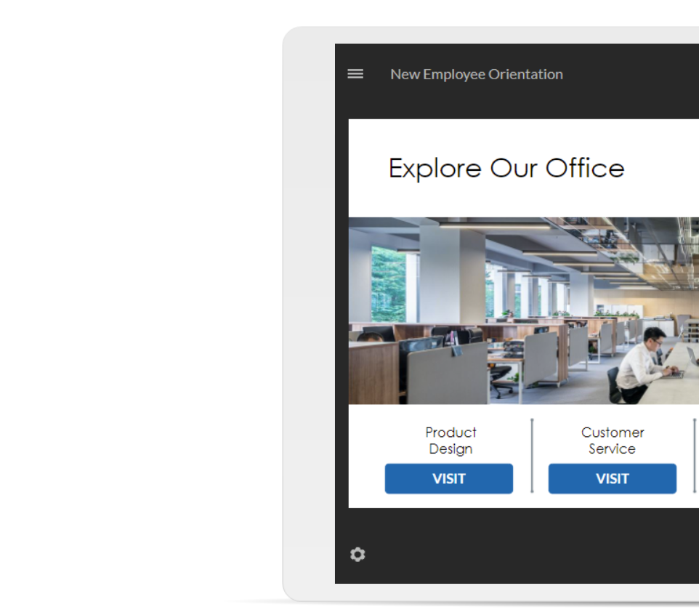
Trend 5: Accessible Visual Design
05
Include image
alt text
Accessible
Visual Design
Notes:
Accessibility has been a growing trend in e-learning. And some of the easiest ways to start improving accessibility involve simple visual design tweaks.

Slide 12
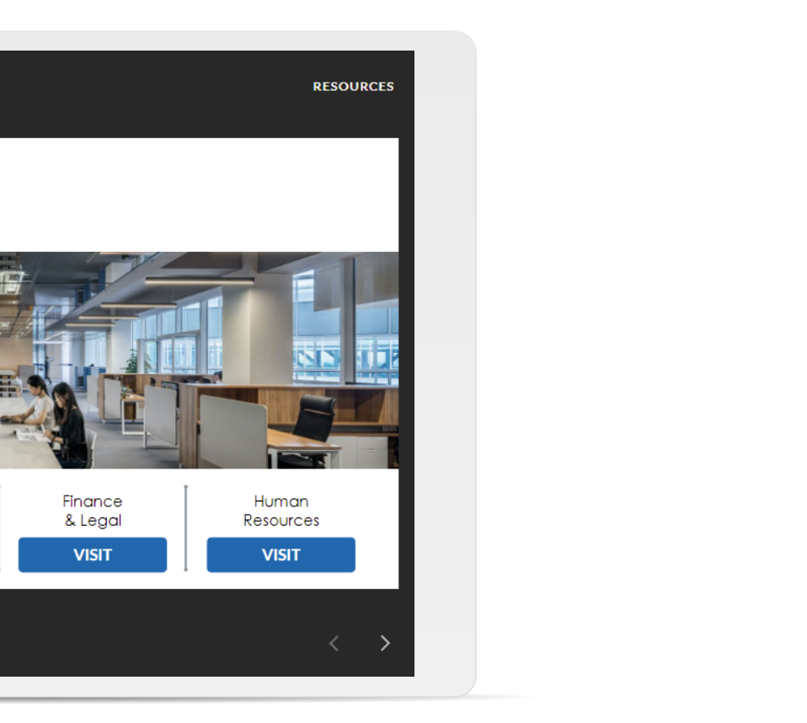
Trend 5: More Information
Just remember:
Check for strong color contrast
Include alt text
Check color contrast
Use large
buttons
Set minimum sizes
Notes:
Adding descriptive alternative (alt) text to non-decorative images gives learners using screenreaders another way to access that visual content. And many apps make it easy to include. Good alt text is succinct and describes what’s important about the image.
Using strong color contrast (the difference in brightness between two colors) makes content easier to see, whether someone has visual impairments or is in poor lighting conditions. Free color checkers (like those listed in this article) can help you ensure your contrast is strong enough.
Setting minimum text size guidelines improves readability. And minimum size guidelines for button sizes ensures they’re easy for everyone to interact with. Learn more about what size standards work best in this article.
ELH Example: Rise 360: Intro to Digital Accessibility for Instructional Designers
Additional reading: All About Accessibility
Additional reading: 6 Easy Ways to Make Your E-Learning More Accessible

Slide 13
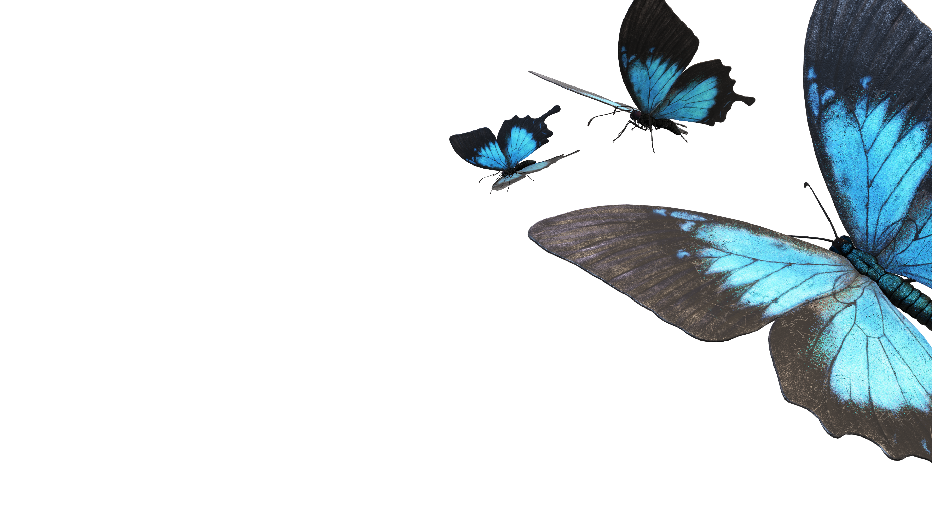
Trend 6: 3D Images and Models
06
3D Images
& Models
Notes:
Improvements in 3D photography and modeling have made it easier than ever to include content that you or your learners can explore from all angles.

Slide 14
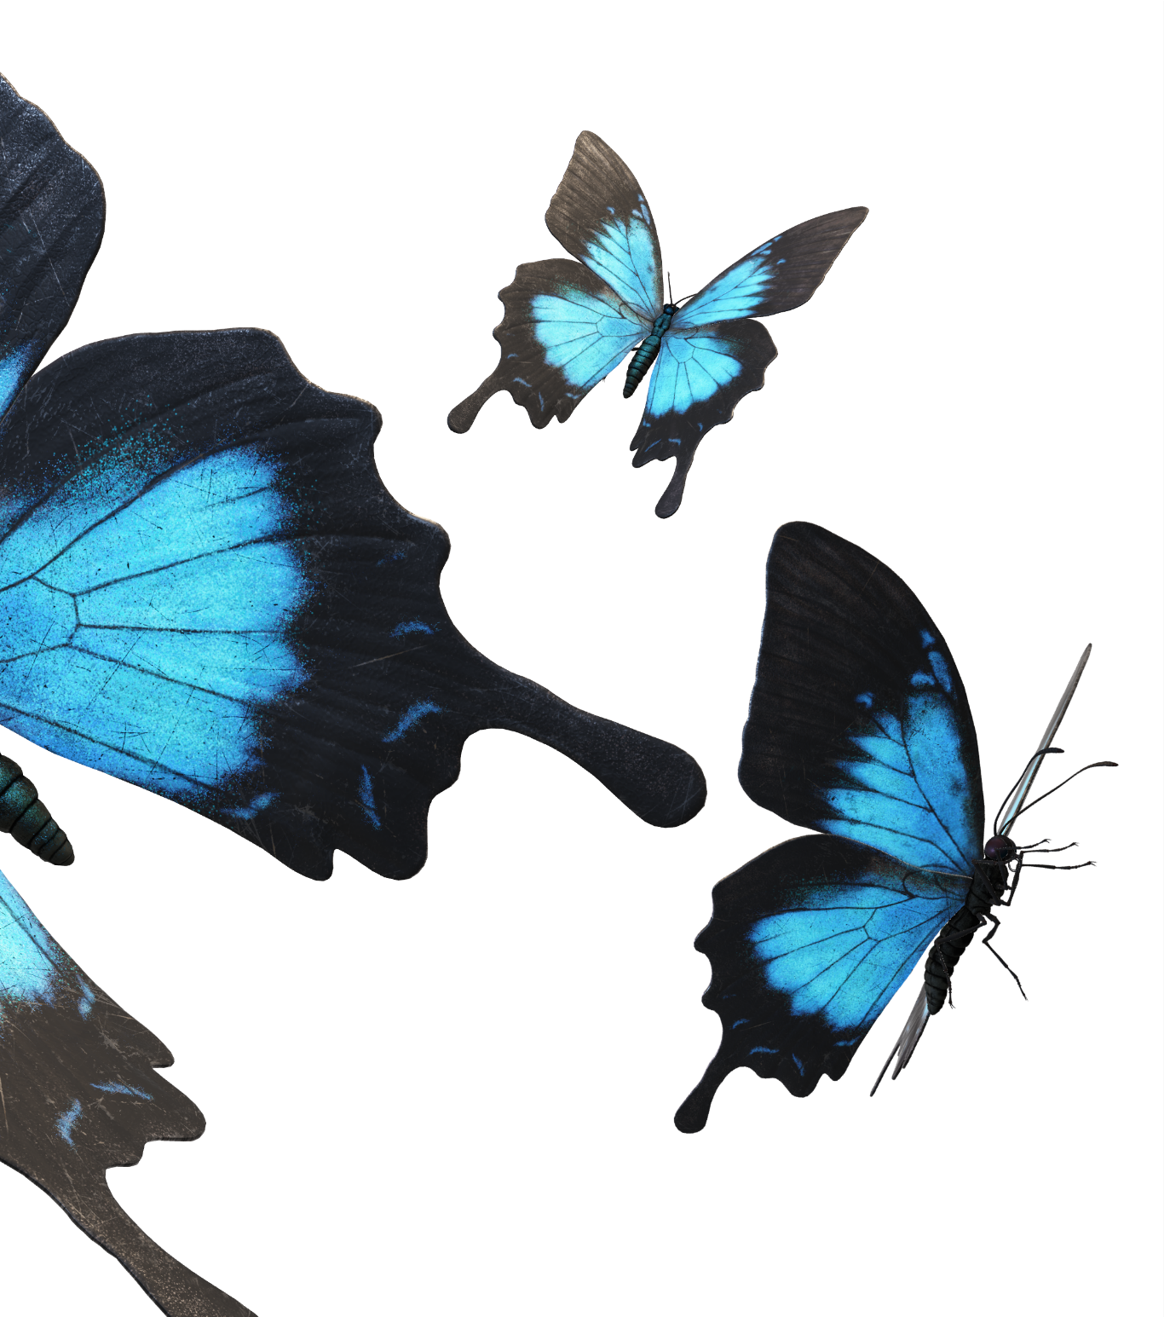
Trend 6: More Information
Just remember:
Try stock image options
Create your own
Notes:
360° photos allow you to immerse learners in an explorable environment—one you can enhance even further with interactions. And as you may have seen with virtual home tours, you can recreate larger environments by linking multiple 360° image slides together. 360° stock photo options are available, but you can also create your own with affordable 360° cameras or even your phone.
3D models make it easy to show an item from different angles. Use one as a static illustration to quickly get the exact view you need. Or capture video of a rotating model to show something from multiple angles. Free and inexpensive 3D models are easy to find online. And if you already have 2D design skills, 3D modeling tools like Blender can be surprisingly simple to pick up.
ELH Example: Storyline: How to Fight a Bear
Additional Reading: How to Find and Create 360° Images for Your Storyline 360 Projects
Additional reading: 7 Tips for Creating Immersive Learning Experiences with Interactive 360° Images

Slide 15


Trend 7: Light and Dark Mode
07
Light &
Dark Mode
Notes:
A setting that’s growing in popularity for phones and apps, Dark Mode shifts your user interface from the typical Light Mode of white/light backgrounds with black text over to dark blacks and grays with white text.
While claims that this approach saves battery life are still up for debate, there are still benefits that make it worth considering. Some people find it easier on their eyes, particularly in low-light situations, the aesthetic is appealing, and it’s a relatively simple way to let learners customize the course to their preferences.

Slide 16
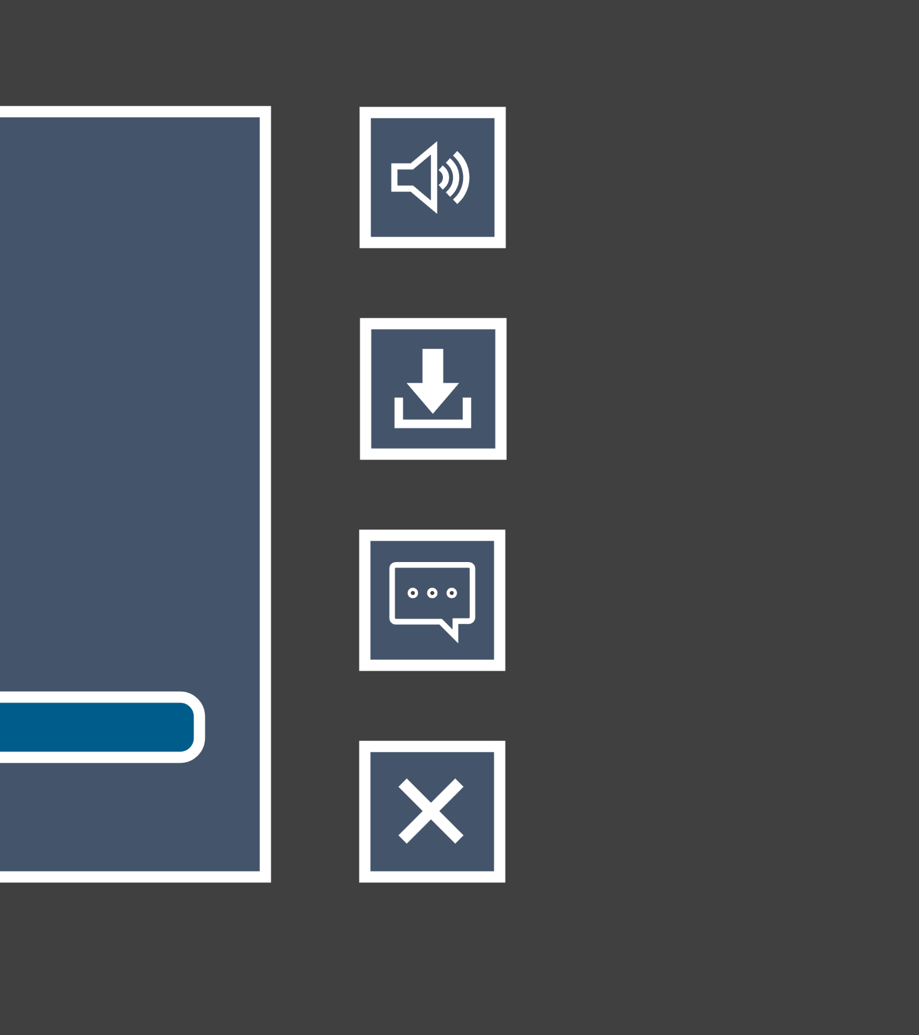
Trend 7: More Information
Just remember:
Experiment with colors
Offer both Dark and Light Mode options
Notes:
Traditionally, Dark Mode involved black and gray as the base colors, but there’s no reason you can’t experiment with other dark colors as well. Also, keep in mind that Dark Mode isn’t universally easier to view. Some learners actually find it harder on their eyes (particularly those with astigmatism), so it’s helpful to give both Dark and Light Modes as options rather than just gravitating to the former.
ELH Example: Storyline: Light Mode/Dark Mode Course Template
Additional reading: 11 Ways to Design Light and Dark E-Learning Templates #351

Slide 17

Trend 8: Grayscale With a Pop
08
Grayscale
with a Pop
Notes:
Limitations can sometimes lead to surprisingly powerful designs. Take the trend of predominantly grayscale designs with one or two bright color accents. When done right, the whites, blacks, and grays lend an air of sophisticated simplicity and the small amounts of vibrant color become incredibly useful tools for directing the eyes. In a learning context, this can be especially useful for highlighting key points as well as sections of images and diagrams.

Slide 18

Trend 8: More Information
Just remember:
Choose shades with sufficient contrast
Experiment to find the right color balance
Notes:
Going back to accessibility, you want to ensure that the grays you choose have a strong contrast against your background.
It’s also worth noting that using too much color can diminish its impact. So you might need to experiment with a few prototype slides to find the right balance of how much color you can add before it shifts from being an eye-catching accent to just another part of the main design.
ELH Example: E-Learning Post-Course Evaluation Questions
ELH Example: Rise 360: Leadership Skills Sketchnote Interaction
ELH Example: Storyline 360: How to Become a Good Leader

